Slide 1

Spatial Variation-Aware Read Disturbance Defenses: Experimental Analysis of Real DRAM Chips and Implications on Future Solutions
Abdullah Giray Yağlıkçı
Yahya Can Tuğrul Geraldo F. Oliveira İsmail Emir Yüksel
Ataberk Olgun Haocong Luo Onur Mutlu
Notes:
Hi my name is Giray and I am happy to share my research with you

Slide 2




Memory Isolation
Data Loss or Corruption
access
Compromise Application Correctness
1 → 0
Leak Private Information
Memory
Take Over a Computer
An access to one memory address
should not have unintended side effects
on data stored in other addresses
Memory isolation is difficult in modern memory chips

Slide 3
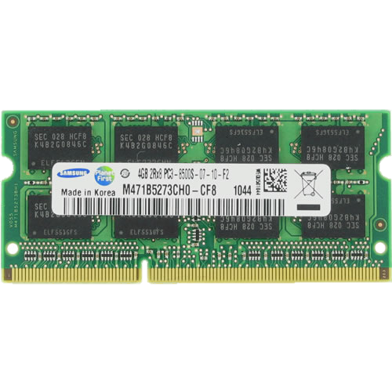
DRAM Organization
Subarray
Bitline
DRAM Cell
Bank
Wordline
…
Chip I/O
. . .
DRAM Row
…
…
…
…
…
Row Buffer
DRAM Chip
DRAM Bank
DRAM Subarray
Notes:
This is a DRAM module, used as the main memory on many systems. [CLICK]
A DRAM module consists of multiple chips each of which contains multiple banks [CLICK]
Each bank is composed of multiple subarrays [CLICK]
And within each subarray, there is a two dimensional array of DRAM cells. [CLICK]
These cells are organized into rows that are selected using wordlines [CLICK]
And the cells are connected to a row buffer via bitlines [CLICK]

Slide 4
DRAM Operation
Bitline
DRAM Cell
Wordline
Wordline
Access transistor
…
DRAM Subarray
…
DRAM Cell
charge
leakage
paths
Capacitor
Bitline
…
…
…
…
Row Buffer
Refresh: Restores the capacitor voltage with a time period called refresh window
I/O Circuitry
Row Activation: Fetch the row’s content into the row buffer
Column Access: Read/Write a column in the row buffer
Precharge: Disconnect the row from the row buffer
Notes:
This is a simplified diagram of a DRAM cell, where the data is stored as capacitor voltage and accessed through the access transistor [CLICK]
A DRAM cell inherently exhibits several charge leakage paths [CLICK]
And requires to perform refresh operations to restore the capacitor voltage with a time period called refresh window.
[PAUSE]
To access a DRAM cell, [CLICK]
the memory controller must first open or activate the row to fetch the row’s data into the row buffer [CLICK]
The READ and WRITE requests targeting the row are serviced from the row buffer [CLICK]
After all requests are serviced from the row, the memory controller must close or precharge the row in order to begin accessing data from another row. [CLICK]

Slide 5
The RowHammer Vulnerability
DRAM Subarray
Row 0
Row 0
Victim Row
Row 1
Row 1
Row 1
Victim Row
Row 2
Row 2
Row 2
Row 2
Row 2
Row 2
open
open
open
closed
closed
Aggressor Row
Aggressor Row
Row 3
Row 3
Row 3
Row 2
Victim Row
closed
Row 4
Row 4
Victim Row
Repeatedly opening (activating) and closing (precharging) a DRAM row causes RowHammer bitflips in nearby cells and breaks memory isolation
Notes:
Due to an increase in cell-to-cell interference, as a result of aggressive technology node scaling, rapidly activating [CLICK] and precharging
[FORTH & BACK] a DRAM row can result in bit flips in physically adjacent rows [CLICK]
[FORTH & BACK] Continuing to access the same row results in even more failures in nearby rows. This phenomenon is known as RowHammer. [CLICK]
We refer to the rapidly accessed row as an aggressor row and the rows containing bit flips as victim rows.

Slide 6
Executive Summary
Motivation:
Read disturbance worsens with technology node scaling
Existing solutions have significant overheads (e.g., performance, energy, cost)
Problem: No rigorous prior work on
Spatial variation of DRAM read disturbance across DRAM rows
Variation’s implications on future solutions
Goal:
To understand the spatial variation in read disturbance across DRAM rows
To leverage this understanding to improve the existing solutions
Experimental study:
144 DDR4 DRAM chips from three major vendors
Characterize all rows in a bank and a bank from each bank group
Takeaway: A large and irregular variation in read disturbance across DRAM rows
Key Idea: Dynamically tune a solution’s aggressiveness (e.g., perform more/less refresh) to the victim row’s vulnerability to DRAM read disturbance
Svärd: Spatial Variation-Aware Read Disturbance Defenses
Tunes the solution’s threshold of performing a preventive action
Implemented either in the DRAM chip or in the memory controller
Evaluation:
Reduces the solution’s performance overhead
Improves system performance significantly (e.g., >2.5x for BlockHammer and RRS)
Notes:
Keep saying Across DRAM rows
Characterize what?
What is a bank group ?
Put the takeaway in experimental results
Correalte Preventive action with aggressiveness

Slide 7
Outline
Motivation and Problem
Motivation and Goal
Experimental Methodology
Temperature Analysis
Aggressor Row Active Time Analysis
Spatial Variation Analysis
Implications on Attacks and Defenses
Conclusions
Our Goal
Experimental Characterization of Real DRAM Chips
Spatial Variation Analysis
Svärd: Spatial Variation-Aware Read Disturbance Defenses
Performance Evaluation
Conclusion
Notes:
This is the outline of the talk. Let me quickly introduce background and problem

Slide 8
Motivation
Technology Scaling
DRAM chips are increasingly more vulnerable to read disturbance with technology scaling
Notes:
With technology node scaling, DRAM chips are getting more vulnerable to read disturbance [CLICK]
and defenses become prohibitively expensive [CLICK]
Therefore, we need a deeper understanding of DRAM read disturbance [CLICK]
to provide effective and efficient solutions [CLICK]
Swap the bars

Slide 9
Motivation
DRAM read disturbance worsens as DRAM chip density increases
Existing solutions become more aggressive
Aggressive preventive behavior makes them prohibitively expensive
Significant performance and energy overhead
Notes:
Quantify

Slide 10
Problem
No prior work rigorously studies
spatial variation of DRAM read disturbance
across all DRAM rows
&
implications on future solutions

Slide 11
Outline
Motivation and Problem
Motivation and Goal
Experimental Methodology
Temperature Analysis
Aggressor Row Active Time Analysis
Spatial Variation Analysis
Implications on Attacks and Defenses
Conclusions
Our Goal
Experimental Characterization of Real DRAM Chips
Spatial Variation Analysis
Svärd: Spatial Variation-Aware Read Disturbance Defenses
Performance Evaluation
Conclusion
Notes:
This is the outline of the talk. Let me quickly introduce background and problem

Slide 12
Our Goal
To understand the spatial variation
in read disturbance across DRAM rows
To leverage this understanding to improve
the existing read disturbance solutions

Slide 13
Outline
Problem
Motivation and Goal
Experimental Methodology
Temperature Analysis
Aggressor Row Active Time Analysis
Spatial Variation Analysis
Implications on Attacks and Defenses
Conclusions
Our Goal
Experimental Characterization of Real DRAM Chips
Spatial Variation Analysis
Svärd: Spatial Variation-Aware Read Disturbance Defenses
Performance Evaluation
Conclusion
Notes:
This is the outline of the talk. Let me quickly introduce background and problem

Slide 14
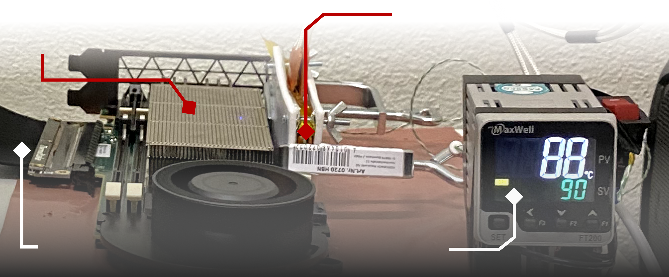
DRAM Testing Infrastructure
DRAM Bender on a Xilinx Virtex UltraScale+ XCU200
Xilinx Alveo U200 FPGA Board (programmed with DRAM Bender*)
DRAM Module with Heaters
PCIe
Host Interface
MaxWell FT200 Temperature Controller
Fine-grained control over DRAM commands,
timing parameters (±1.5ns), and temperature (±0.5°C )
*Olgun et al., "DRAM Bender: An Extensible and Versatile FPGA-Based Infrastructure to Easily Test State-of-the-Art DRAM Chips,” TCAD, 2023. [GitHub: https://github.com/CMU-SAFARI/DRAM-Bender]
Notes:
We use an FPGA-based experimental setup programmed with a modified version of SoftMC [CLICK]
This infrastructure provides us with a fine-grained control over DRAM commands, timing parameters, and temperature [CLICK]
=======
Fix the link

Slide 15
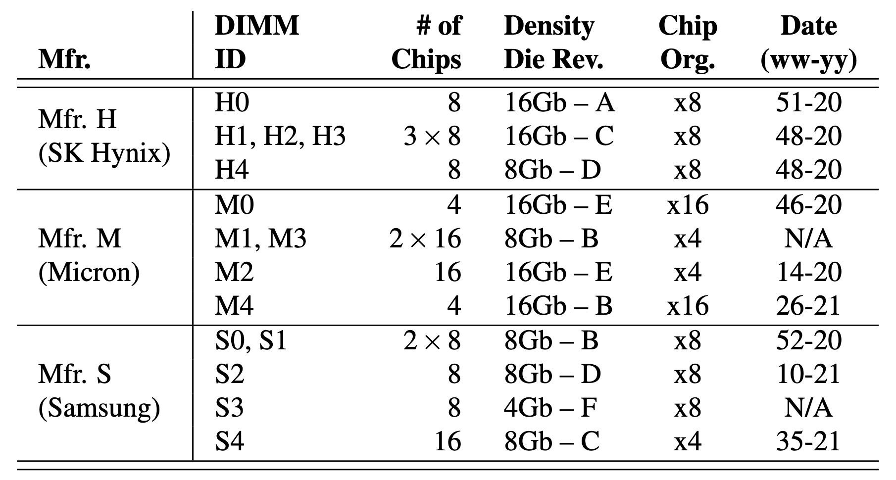
Tested DRAM Chips
144 DRAM chips from SK Hynix, Micron, and Samsung
Notes:
And show that there is a large variation in read disturbance across rows

Slide 16
Key Takeaway from Real Chip Experiments
Read disturbance vulnerability varies
significantly and irregularly across DRAM rows
Notes:
And show that there is a large variation in read disturbance across rows

Slide 17
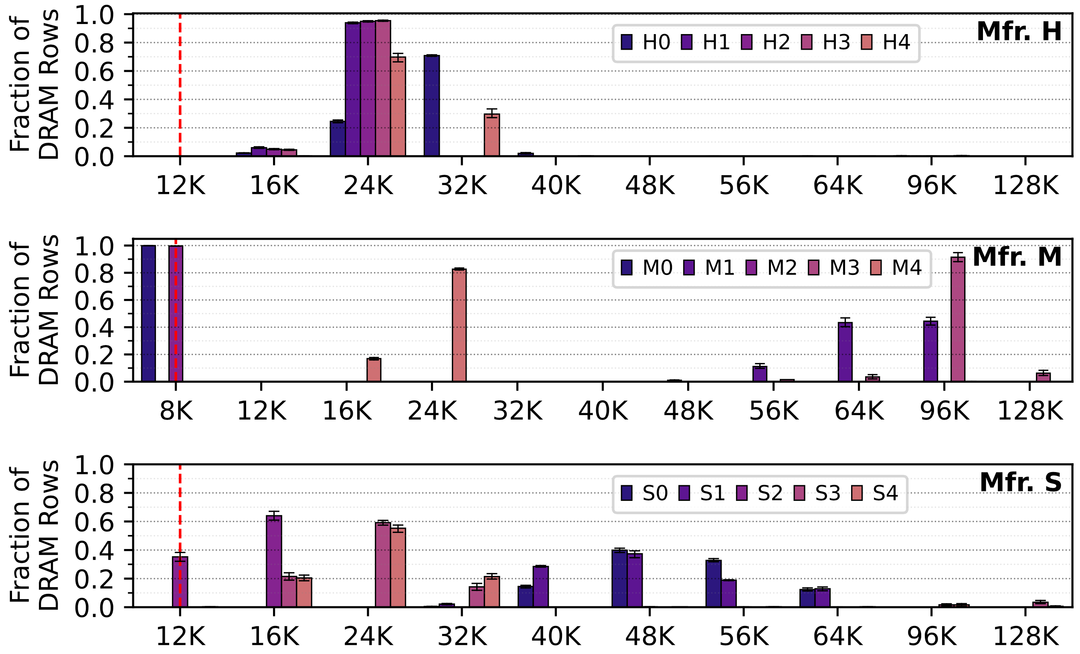
Spatial Variation in the Minimum Hammer Count to Induce the First Bitflip across DRAM Rows
Variation across banks
Different DRAM modules
Fraction of DRAM Rows
Worst
HC_{first}
Minimum Hammer Count to Induce the First Bitflip (HC_{first})
S0
S1
S2
S3
S4
The minimum hammer count to induce the first bitflip
significantly varies across rows in a DRAM bank
Notes:
And show that there is a large variation in read disturbance across rows
Animate the figure

Slide 18
Spatial Variation in the Minimum Hammer Count to Induce the First Bitflip across DRAM Rows
Minimum Hammer Count to Induce the First Bitflip (HC_{first})
Notes:
Start with S
Annotate the variation

Slide 19
Spatial Variation in the Minimum Hammer Count to Induce the First Bitflip across DRAM Rows
The minimum hammer count to induce the first bitflip
significantly varies across rows in a DRAM bank
Minimum Hammer Count to Induce the First Bitflip (HC_{first})

Slide 20
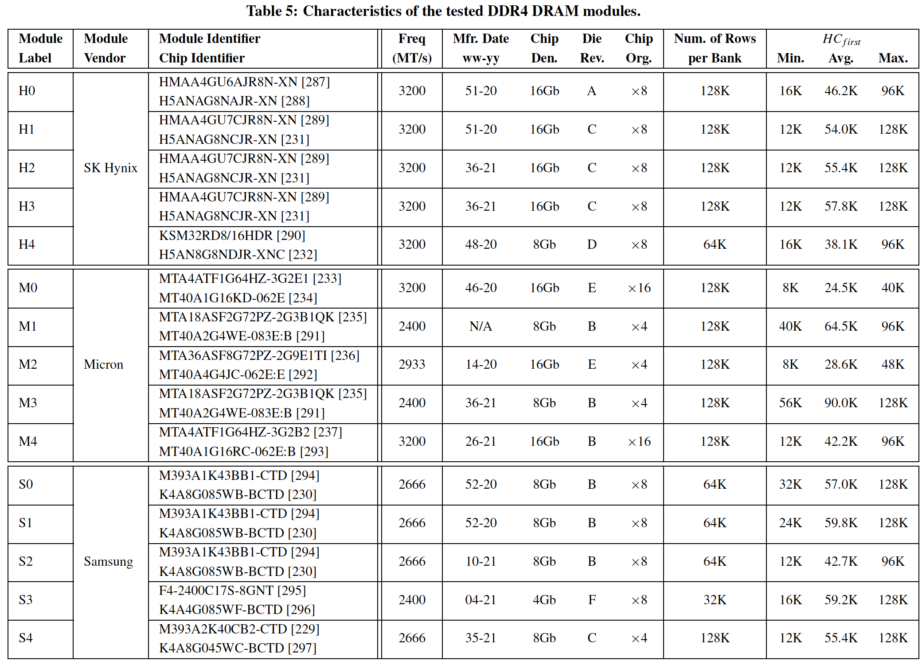
More Detailed Information in the Extended Version
https://arxiv.org/pdf/2402.18652.pdf

Slide 21
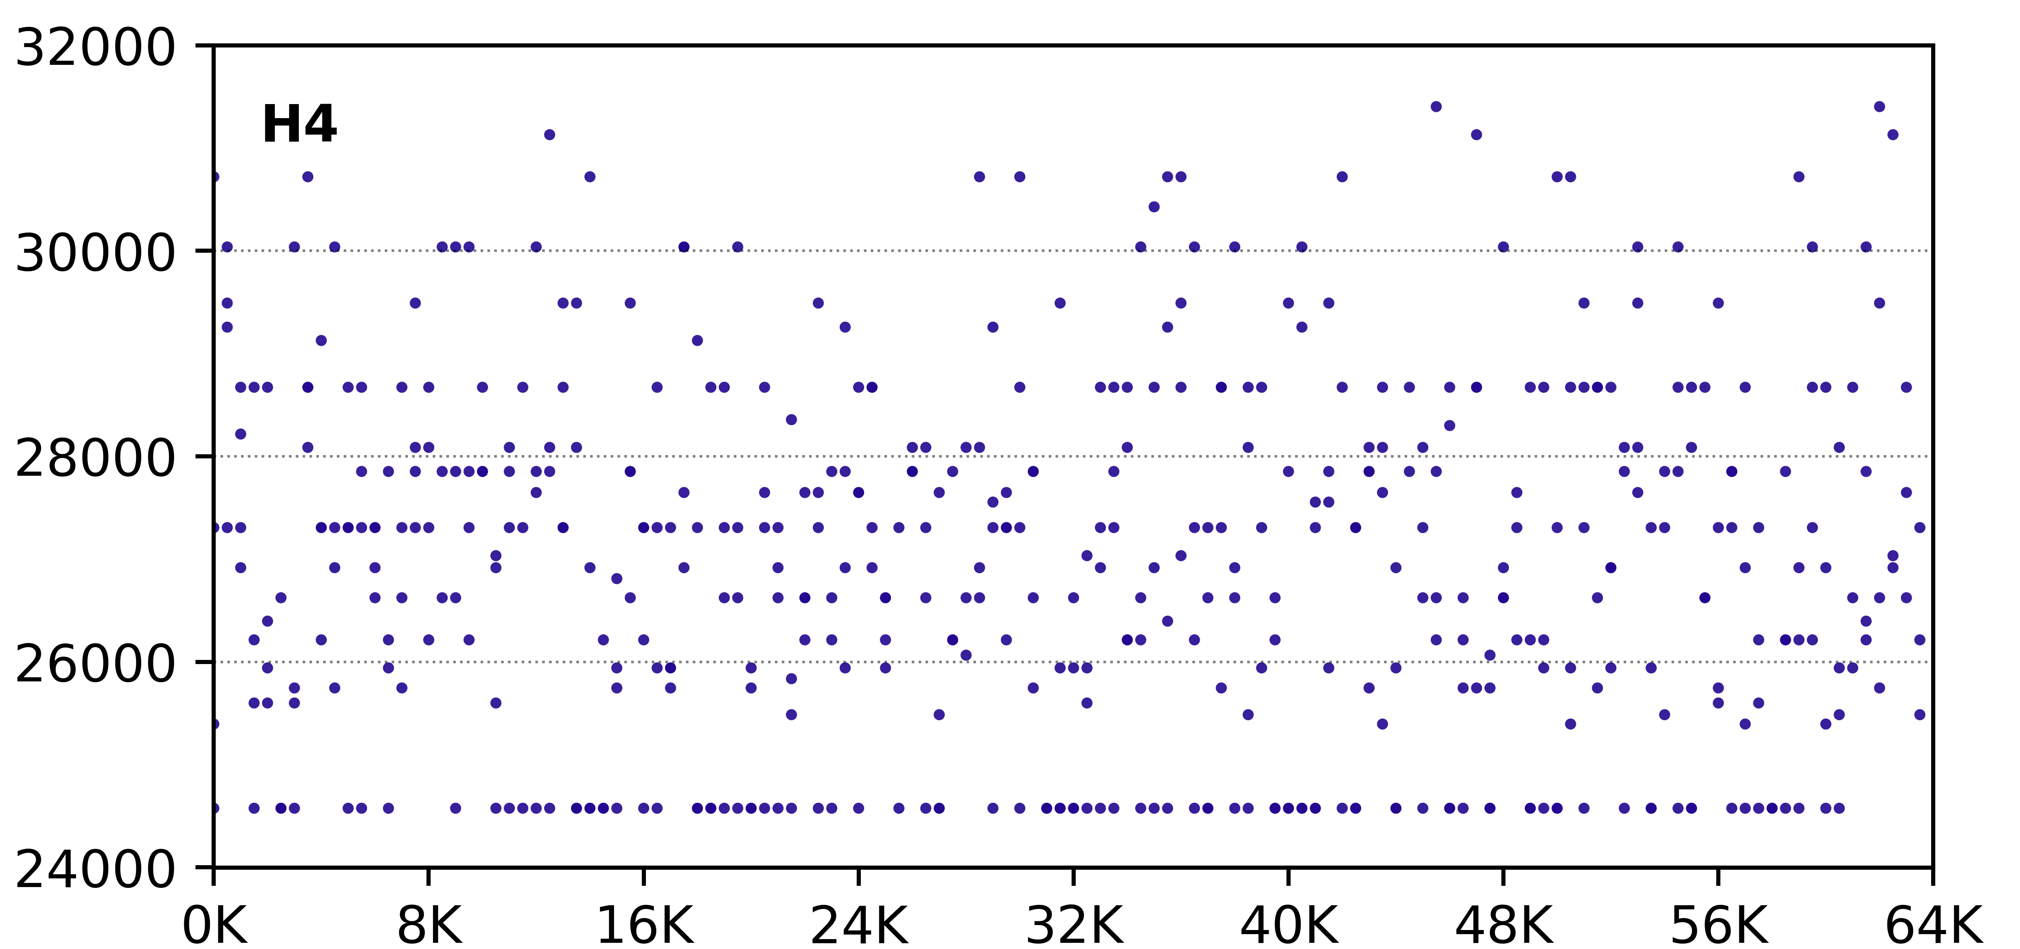
Regularity in Spatial Variation of DRAM Read Disturbance across DRAM Rows
No visible regularity in HC_{first} based on the row’s location
The minimum hammer count
to induce the first bitflip (HC_{first})
DRAM Row Address
The minimum hammer count to induce the first bitflip
irregularly varies with respect to row’s location in DRAM bank
Notes:
There are different bins but do not correlate well with the row address
Zoom in to one module
X-axis beginning – middle- end
Absolute numbers in the y-axis
Revise the title

Slide 22
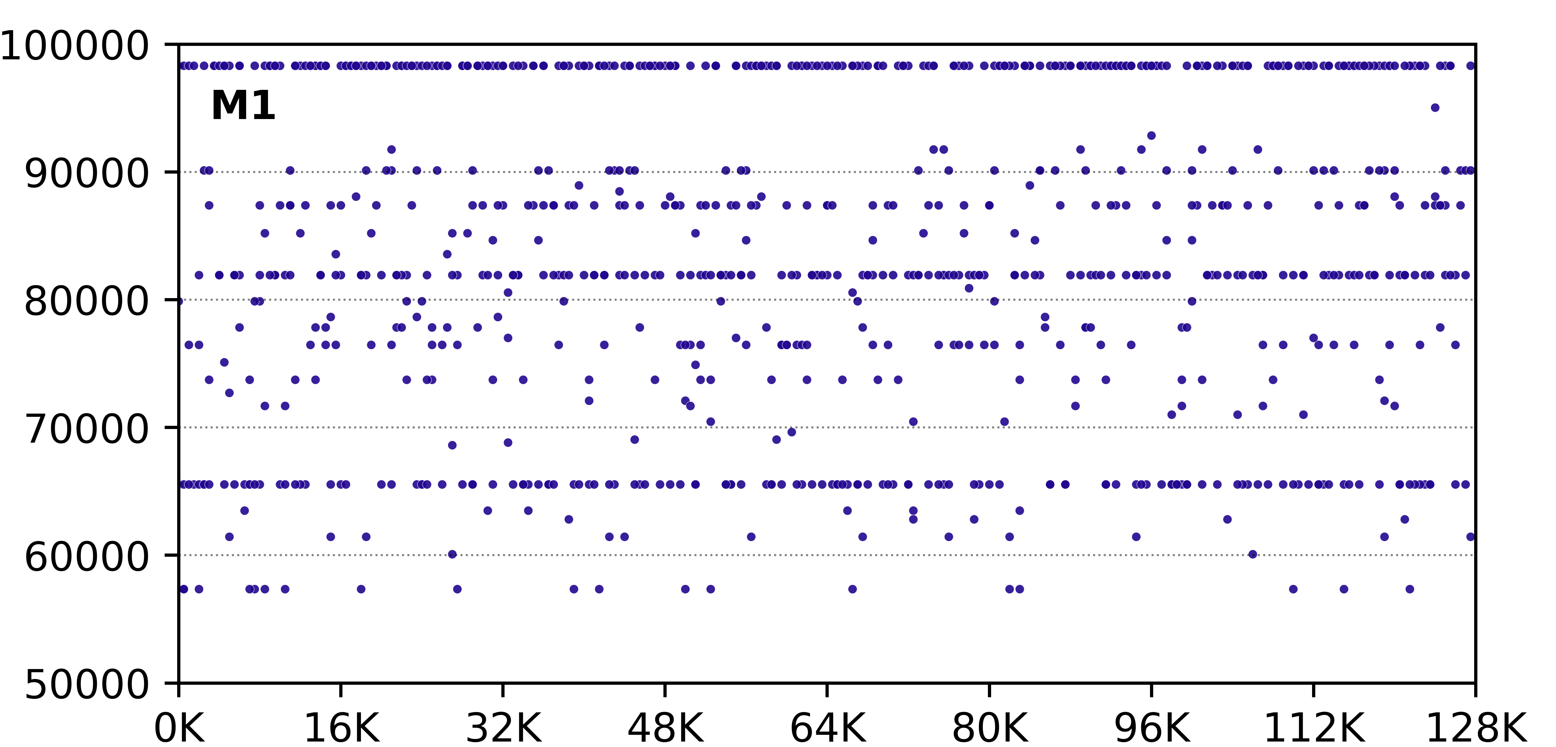
Regularity in Spatial Variation of DRAM Read Disturbance across DRAM Rows
No visible regularity in HC_{first} based on the row’s location
The minimum hammer count
to induce the first bitflip (HC_{first})
DRAM Row Address
The minimum hammer count to induce the first bitflip
irregularly varies with respect to row’s location in DRAM bank
Notes:
There are different bins but do not correlate well with the row address
Zoom in to one module
X-axis beginning – middle- end
Absolute numbers in the y-axis
Revise the title

Slide 23
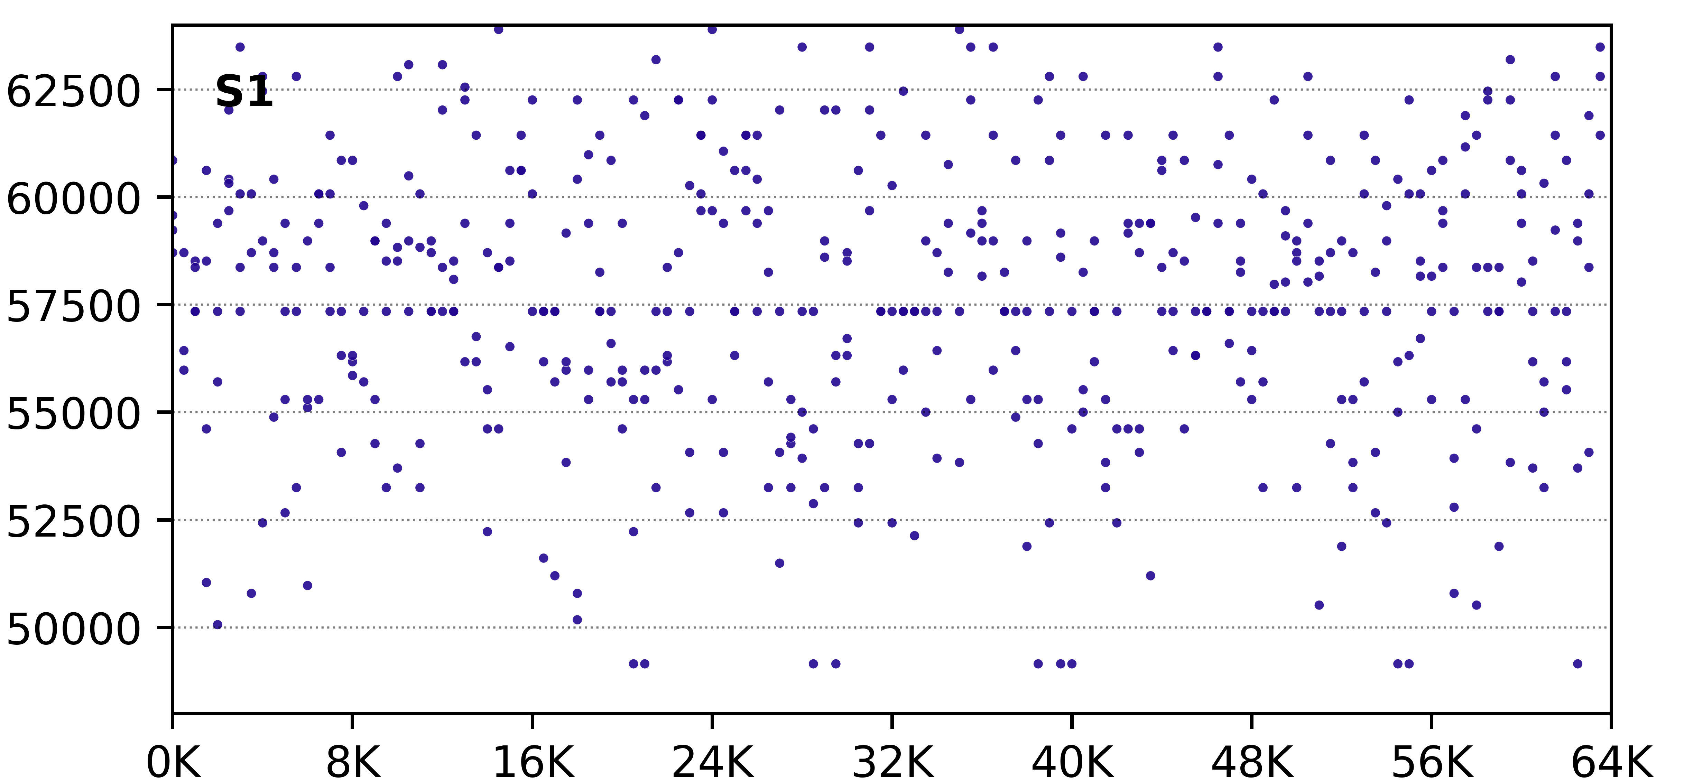
Regularity in Spatial Variation of DRAM Read Disturbance across DRAM Rows
No visible regularity in HC_{first} based on the row’s location
The minimum hammer count
to induce the first bitflip (HC_{first})
DRAM Row Address
The minimum hammer count to induce the first bitflip
irregularly varies with respect to row’s location in DRAM bank
Notes:
There are different bins but do not correlate well with the row address
Zoom in to one module
X-axis beginning – middle- end
Absolute numbers in the y-axis
Revise the title

Slide 24
Outline
Problem
Motivation and Goal
Experimental Methodology
Temperature Analysis
Aggressor Row Active Time Analysis
Spatial Variation Analysis
Implications on Attacks and Defenses
Conclusions
Our Goal
Experimental Characterization of Real DRAM Chips
Spatial Variation Analysis
Svärd: Spatial Variation-Aware Read Disturbance Defenses
Performance Evaluation
Conclusion
Notes:
This is the outline of the talk. Let me quickly introduce background and problem

Slide 25
Predictability of Spatial Variation
Predictability of
a DRAM row’s read disturbance vulnerability
based on the row’s spatial features
bank address bits
subarray address bits
row address bits
row’s distance to local row buffer
Methodology
Cluster DRAM rows into 15 bins based on each row’s minimum hammer count to induce the first bitflip (HC_{first})
Predict whether a row is in a cluster or not based on each spatial feature
Measure the F1 score for each spatial feature
Key Result: Only a few spatial features have F1 scores > 0.7 only for Mfr. S
No good prediction observed between a row’s spatial features & read disturbance vulnerability
Notes:
In summary, BlockHammer is the first work to practically enable throttling-based RowHammer mitigation and [CLICK]
it is implemented solely in the memory controller without requiring proprietary information of or modifications to DRAM chips [CLICK]
It overcomes both scalability and compatibility challenges [CLICK]
To further aid future research and development, we make BlockHammer’s source code freely and openly available
GET RID OF ALL CORRELATION
Box figure
Make it better

Slide 26
Key Takeaway from Real Chip Experiments
Read disturbance vulnerability varies
significantly and irregularly across DRAM rows
Notes:
And show that there is a large variation in read disturbance across rows

Slide 27
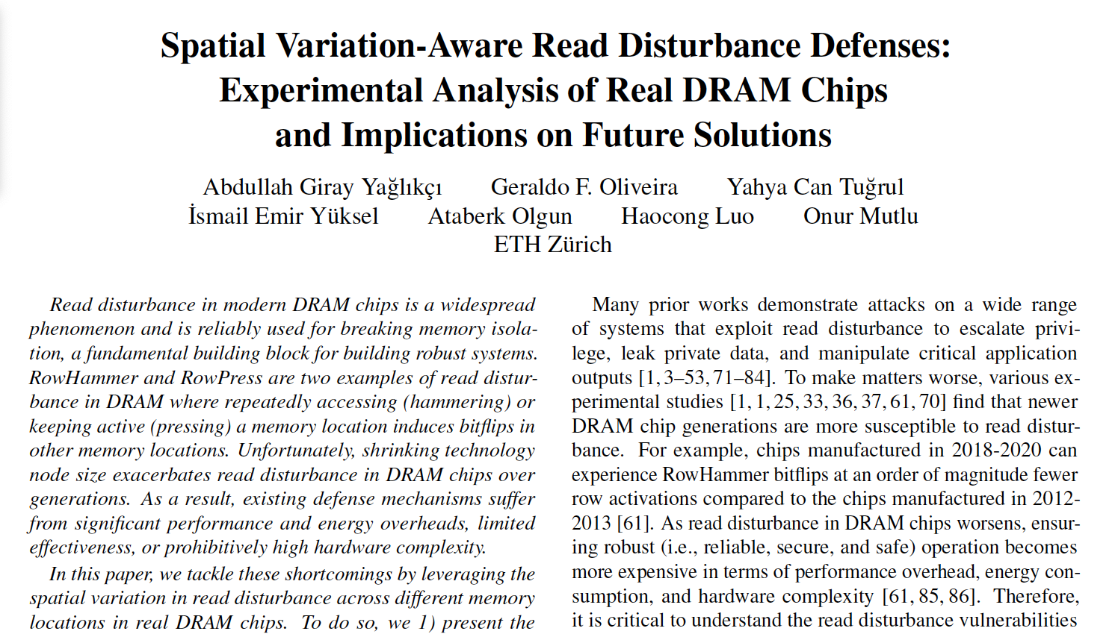
More in the Paper
Spatial variation in read disturbance bit error rate across rows
Spatial variation of RowPress across DRAM rows
Algorithms and details of our experiments
Reverse-engineering of subarray boundaries
Hardware Complexity Analysis
Chip area cost
Either 0.43% of a processor die per DRAM rank with 16 banks in the memory contr.
0.006% increase in the DRAM array (4 bits / 8KB)
No additional latency overhead
A preliminary analysis of the effect of aging on DRAM read disturbance vulnerability
https://arxiv.org/pdf/2402.18652.pdf

Slide 28
Outline
Problem
Motivation and Goal
Experimental Methodology
Temperature Analysis
Aggressor Row Active Time Analysis
Spatial Variation Analysis
Implications on Attacks and Defenses
Conclusions
Our Goal
Experimental Characterization of Real DRAM Chips
Spatial Variation Analysis
Svärd: Spatial Variation-Aware Read Disturbance Defenses
Performance Evaluation
Conclusion
Notes:
This is the outline of the talk. Let me quickly introduce background and problem

Slide 29
Svärd: Spatial Variation-Aware Read Disturbance Defenses
Key Experimental Takeaway: Read disturbance vulnerability varies significantly and irregularly across DRAM rows
Key Idea: Leverage the variation in read disturbance vulnerability across DRAM rows
Svärd: Spatial Variation-Aware DRAM Read Disturbance Defenses Dynamically tunes the aggressiveness of existing solutions to the victim row’s read disturbance vulnerability
Svärd performs fewer preventive actions (e.g., refresh) for rows that are less vulnerable to read disturbance
Svärd significantly reduces the performance overhead of existing solutions
Svärd is Swedish for sword, a weapon with a long blade for cutting or thrusting [Merriam-Webster]
Notes:
We leverage this observation [CLICK]
By protecting weak rows more aggressively than strong rows [CLICK]
We do this by dynamically tuning the aggressiveness of defense mechanisms [CLICK]
and we show significant improvement in system performance. [CLICK]
Too high level
Put ataberk’s explanation here

Slide 30
Svärd: Spatial Variation-Aware Read Disturbance Defenses Integration Showcase
Integrate Svärd with five solutions
PARA [Kim+, ISCA’14]
Generates a random number
Compares the random number with a threshold
Refreshes the victim row if the random number exceeds the threshold
BlockHammer [Yaglikci+, HPCA’21]
Counts the number of activations per DRAM row
Compares the activation count with a threshold
Throttles accesses to the aggressor row if the activation count reaches the threshold
Hydra [Qureshi+, ISCA’22]
Counts the number of activations per DRAM row
Compares the activation count with a threshold
Refreshes the victim row when the activation count reaches the threshold
AQUA [Saxena+, MICRO’22] and RRS [Saileshwar+, ASPLOS’22]
Counts the number of activations per DRAM row
Compares the activation count with a threshold
Relocates the aggressor row when the activation count reaches the threshold
Svärd tunes the threshold based on the victim row’s vulnerability
Svärd is Swedish for sword, a weapon with a long blade for cutting or thrusting [Merriam-Webster]
Notes:
We leverage this observation [CLICK]
By protecting weak rows more aggressively than strong rows [CLICK]
We do this by dynamically tuning the aggressiveness of defense mechanisms [CLICK]
and we show significant improvement in system performance. [CLICK]
Too high level
Put ataberk’s explanation here

Slide 31
Svärd: Spatial Variation-Aware Read Disturbance Defenses Implementation Showcase 1
Classifies DRAM rows into several vulnerability-level bins
Maintains a few (e.g., four) bits per DRAM row
Implemented in either the memory controller or the DRAM chip
The memory controller-based implementation:
Memory Controller
Memory
Request
DRAM Commands, Address, Data
Memory
Request
Scheduler
HC_{first} Table
Row
Addr
Existing Read
Disturbance
Solution
DRAM
Chip
HC_{first}
Metadata
Bits
Preventive Action
Data
Two potential ways of handling metadata
Svärd is Swedish for sword, a weapon with a long blade for cutting or thrusting [Merriam-Webster]
Notes:
Too busy
Make either or more obvious
Table in the dram chip
Why memory controllers?
s/w based metadata?

Slide 32
Svärd: Spatial Variation-Aware Read Disturbance Defenses Implementation Showcase 2
Classifies DRAM rows into several vulnerability-level bins
Maintains a few (e.g., four) bits per DRAM row
Implemented in either the memory controller or the DRAM chip
The DRAM chip-based implementation:
Additional few (e.g., four) bits per DRAM row (e.g., 8Kb)
DRAM Chip
DRAM
command
address
data
DRAM Subarray
DRAM Row
Existing Read
Disturbance
Solution
DRAM Row
Refresh
Controller
I/O Periphery
DRAM Row
HC_{first} Bin
Row Buffer
Preventive Action
Data
Svärd is Swedish for sword, a weapon with a long blade for cutting or thrusting [Merriam-Webster]

Slide 33
Outline
Problem
Motivation and Goal
Experimental Methodology
Temperature Analysis
Aggressor Row Active Time Analysis
Spatial Variation Analysis
Implications on Attacks and Defenses
Conclusions
Our Goal
Experimental Characterization of Real DRAM Chips
Spatial Variation Analysis
Svärd: Spatial Variation-Aware Read Disturbance Defenses
Performance Evaluation
Conclusion
Notes:
This is the outline of the talk. Let me quickly introduce background and problem

Slide 34
Performance Evaluation
Cycle-level simulations using Ramulator 2.0 [Luo+, CAL 2023]
System Configuration:
Workloads: 120 different 8-core multiprogrammed workloads from SPEC CPU2006, SPEC CPU2017, TPC, MediaBench, and YCSB benchmark suites
Paired with AQUA, BlockHammer, PARA, Hydra, and RRS
HC_{first}: {4K, 2K, 1K, 512, 256, 128, 64} hammers The minimum hammer count needed to induce the first bitflip
Processor | 3.2 GHz, 8 core, 4-wide issue, 128-entry instr. window
Last-Level Cache | 64-byte cache line, 8-way set-associative, 8 MB
Memory Scheduler | FR-FCFS
Address Mapping | Minimalistic Open Pages
Main Memory | DDR4, 4 bank group, 4 banks per bank group (16 banks per rank)
Notes:
We use Ramulator for cycle-level simulations in our performance evaluation [CLICK]
We simulate a realistic system with the shown parameters that I will not explain in detail [CLICK]
We simulate 125 different 8-core multiprogrammed workloads [CLICK]
We sweep DRAM chip capacity from 2Gb to 128Gb [CLICK]
And RowHammer threshold: the minimum number of activations needed to induce the first RowHammer bit flip from 1K to 64 [CLICK]
Really ugly
Font size

Slide 35
Implications on Future Solutions
PARA
Reduction in Performance Overhead
Weighted Speedup
(Norm. to No Mitigation Baseline)
1.57x
Speedup
Minimum Hammer Count to Induce the First Bitflip
Notes:
Talk about the profiles
Animate the profile curves one by one
Excel everything

Slide 36
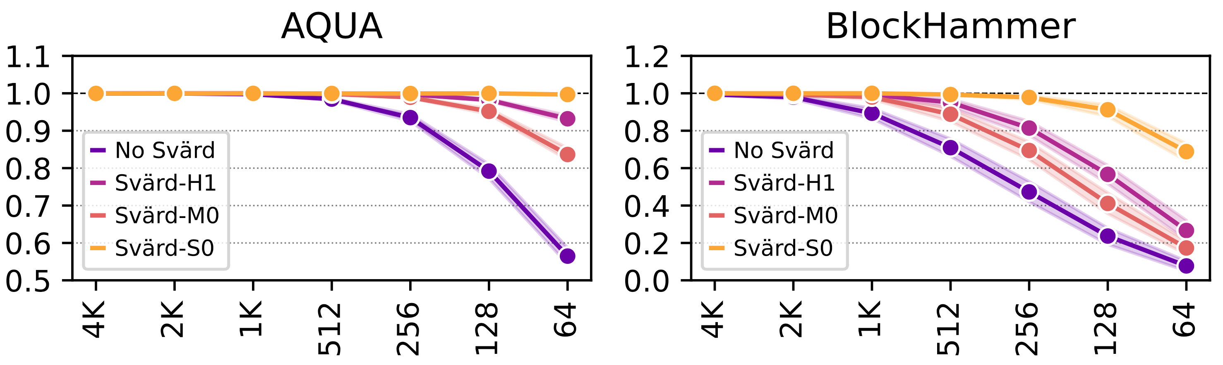
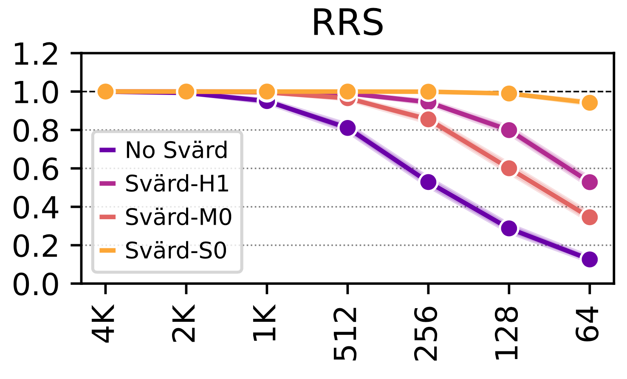
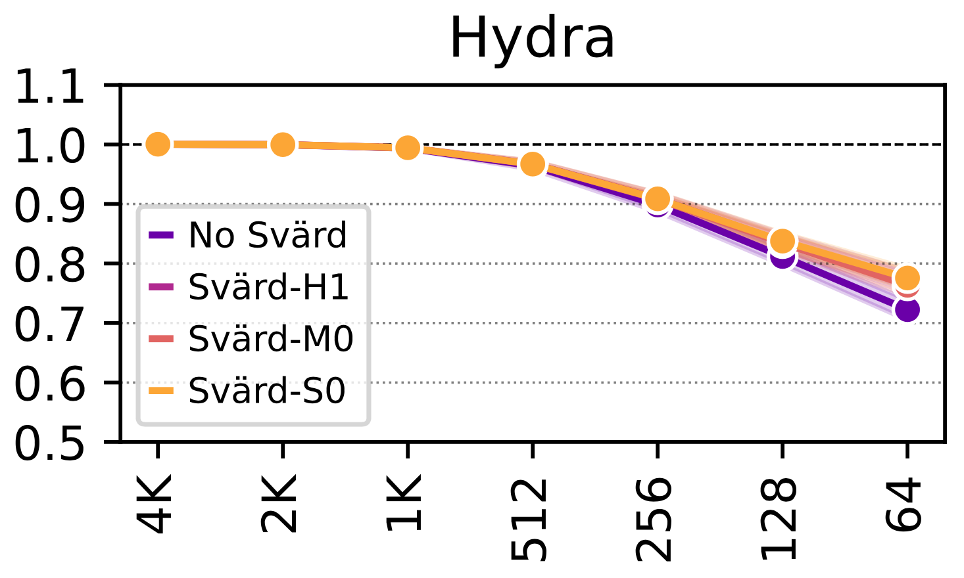
Implications on Future Solutions
Weighted Speedup
(Norm. to No Mitigation Baseline)
Minimum Hammer Count to Induce the First Bitflip

Slide 37
Implications on Future Solutions
1.23x Speedup
2.65x Speedup
Svärd significantly reduces the performance overhead of existing solutions
Weighted Speedup
(Norm. to No Mitigation Baseline)
2.76x Speedup
1.03x Speedup
Minimum Hammer Count to Induce the First Bitflip
Notes:
Assume that an attacker hammers a row to induce bit flips in its nearby rows [CLICK]
Existing RowHammer defenses detect the attack [CLICK]
And try refreshing the nearby rows [CLICK]
However, the DRAM chip can internally map these row addresses to different physical rows [CLICK]
And thus bit flips may still occur[CLICK]
To avoid this, existing mechanisms need to know proprietary DRAM-internal row address mapping [CLICK]

Slide 38
More in the Paper
Spatial variation in read disturbance bit error rate across rows
Spatial variation of RowPress [Luo+ ISCA23] across DRAM rows
Algorithms and details of our experiments
Reverse-engineering of subarray boundaries
Hardware in Complexity Analysis
Chip area cost
MC-based: 0.027% of a processor die per DRAM bank
DRAM-based: 0.006% increase the DRAM array (4 bits per row per chip)
No additional latency overhead
A preliminary analysis of the effect of aging on DRAM read disturbance vulnerability
Notes:
Hydra style implementation?

Slide 39
More in the Paper
Spatial variation in read disturbance bit error rate across rows
Spatial variation of RowPress across DRAM rows
Algorithms and details of our experiments
Reverse-engineering of subarray boundaries
Hardware Complexity Analysis
Chip area cost
Either 0.43% of a processor die per DRAM rank with 16 banks in the memory contr.
0.006% increase in the DRAM array (4 bits / 8KB)
No additional latency overhead
A preliminary analysis of the effect of aging on DRAM read disturbance vulnerability
https://arxiv.org/pdf/2402.18652.pdf

Slide 40
Outline
Problem
Motivation and Goal
Experimental Methodology
Temperature Analysis
Aggressor Row Active Time Analysis
Spatial Variation Analysis
Implications on Attacks and Defenses
Conclusions
Our Goal
Experimental Characterization of Real DRAM Chips
Spatial Variation Analysis
Svärd: Spatial Variation-Aware Read Disturbance Defenses
Performance Evaluation
Conclusion
Notes:
This is the outline of the talk. Let me quickly introduce background and problem

Slide 41
Conclusion
The first rigorous experimental study on the spatial variation of DRAM read disturbance across DRAM rows
144 DDR4 DRAM chips from three major vendors
Characterize all rows in a bank and a bank from each bank group
Key Idea: Dynamically tune a solution’s aggressiveness (e.g., perform more/less refresh) to the victim row’s vulnerability to DRAM read disturbance
Svärd: Spatial Variation-Aware Read Disturbance Defenses
Tunes the solution’s threshold of performing a preventive action
Implemented either in the DRAM chip or in the memory controller
Read disturbance vulnerability varies significantly and irregularly across DRAM rows
Svärd significantly reduces the performance overhead of existing solutions
Notes:
RowHammer is a worsening DRAM reliability and security problem [CLICK]
However, state-of-the-art RowHammer mitigation mechanisms face limitations supporting current and future commodity DRAM chips because of two challenges [CLICK]
First, they cannot scale efficiently with worsening RowHammer vulnerability[CLICK]
Second, they are not compatible with commodity DRAM chips as they rely on proprietary information [CLICK]
To overcome these two challenges, our key idea is to SELECTIVELY throttle memory accesses that may cause RowHammer bit flips
Check Hermes Venice Morpheus and Victima rewrite

Slide 42

Spatial Variation-Aware Read Disturbance Defenses: Experimental Analysis of Real DRAM Chips and Implications on Future Solutions
Full Paper
Abdullah Giray Yağlıkçı
Yahya Can Tuğrul Geraldo F. Oliveira İsmail Emir Yüksel
Ataberk Olgun Haocong Luo Onur Mutlu
Notes:
Hi my name is Giray and I am happy to share my research with you

Slide 43
Spatial Variation-Aware Read Disturbance Defenses: Experimental Analysis of Real DRAM Chips and Implications on Future Solutions
Backup Slides
Abdullah Giray Yağlıkçı
Yahya Can Tuğrul Geraldo F. Oliveira İsmail Emir Yüksel
Ataberk Olgun Haocong Luo Onur Mutlu
Notes:
Hi my name is Giray and I am happy to share my research with you

Slide 44
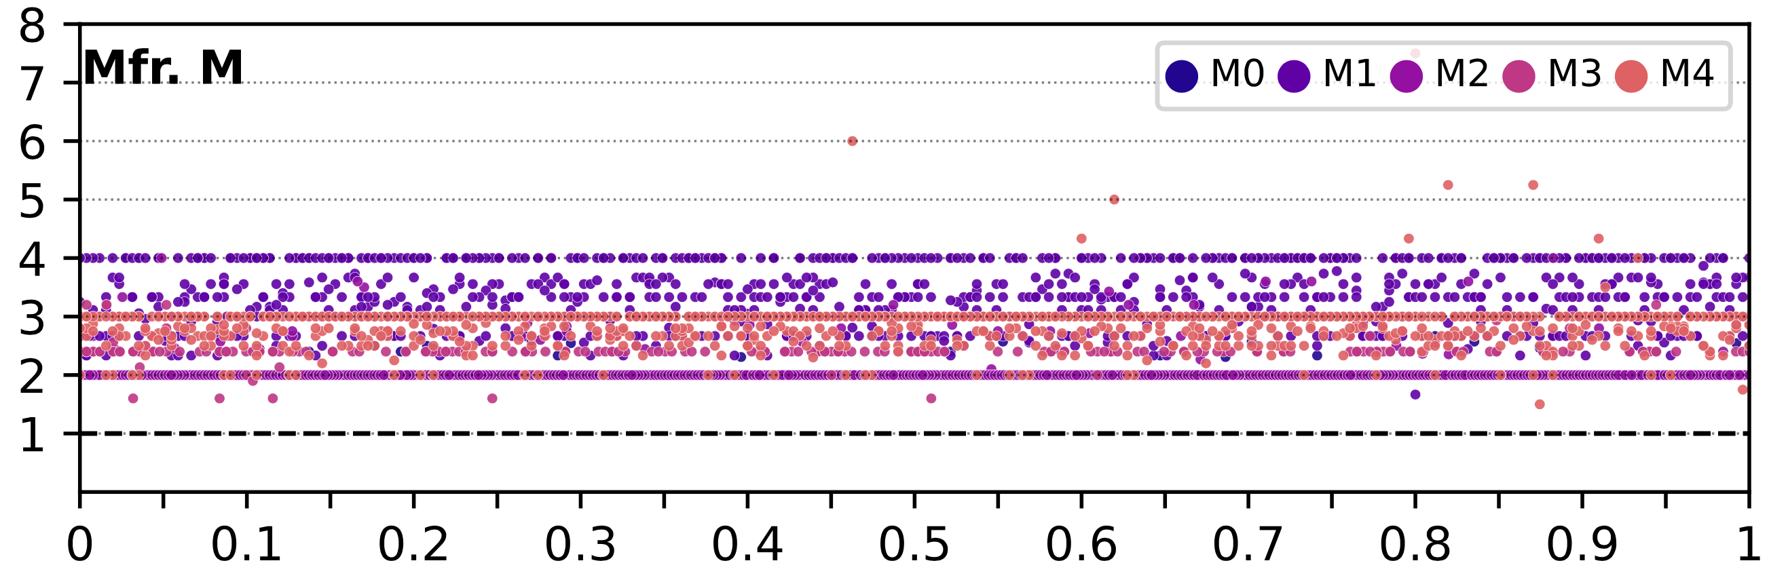
The Minimum Hammer Count to Induce the First Bitflip across DRAM Rows
No visible regularity in HC_{first} based on the row’s location
The minimum hammer count
to induce the first bitflip (HC_{first}) Norm. to the Lowest Hc_{first} in the module
Relative location of a DRAM row
(0 and 1 are the two edges of a DRAM bank)
The minimum hammer count to induce the first bitflip
irregularly varies with respect to row’s location in DRAM bank

Slide 45
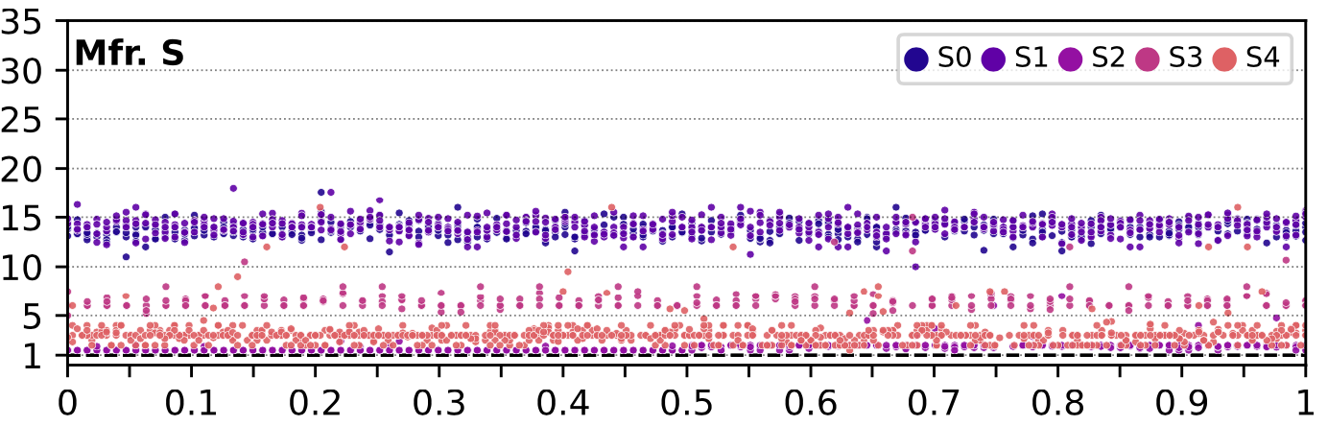
The Minimum Hammer Count to Induce the First Bitflip across DRAM Rows
No visible regularity in HC_{first} based on the row’s location
The minimum hammer count
to induce the first bitflip (HC_{first}) Norm. to the Lowest Hc_{first} in the module
Relative location of a DRAM row
(0 and 1 are the two edges of a DRAM bank)
The minimum hammer count to induce the first bitflip
irregularly varies with respect to row’s location in DRAM bank

Slide 46
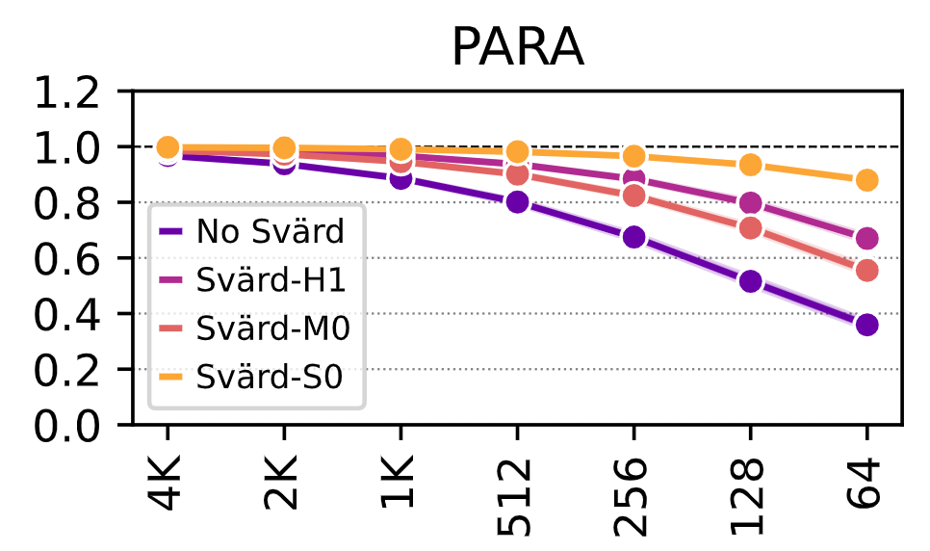
Implications on Future Solutions
Weighted Speedup
(Norm. to No Mitigation Baseline)
Minimum Hammer Count to Induce the First Bitflip
Notes:
Assume that an attacker hammers a row to induce bit flips in its nearby rows [CLICK]
Existing RowHammer defenses detect the attack [CLICK]
And try refreshing the nearby rows [CLICK]
However, the DRAM chip can internally map these row addresses to different physical rows [CLICK]
And thus bit flips may still occur[CLICK]
To avoid this, existing mechanisms need to know proprietary DRAM-internal row address mapping [CLICK]

Slide 47
Read Disturbance in DRAM
Increasing focus on exploiting, understanding, and solving DRAM read disturbance
Notes:
More papers focus on [CLICK]
exploiting [CLICK]
understanding [CLICK]
and solving [CLICK]
read disturbance [CLICK]

Slide 48
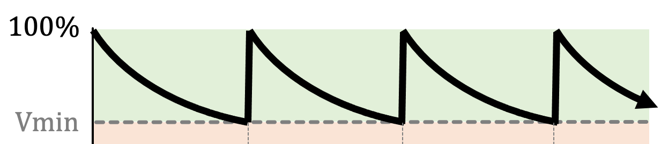
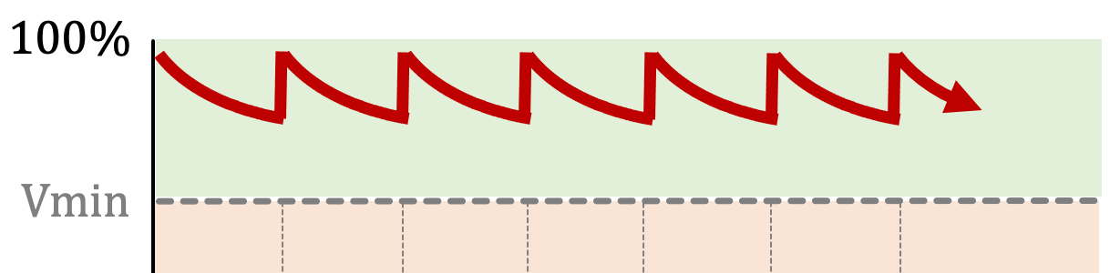


RowHammer Mitigation Approaches
Increased refresh rate
Physical isolation
Reactive refresh
Proactive throttling
REF-to-REF time reduces
Fewer activations can fit
DRAM Bank
Aggressor Row
Isolation Rows
Large-enough distance
Victim Rows
DRAM Bank
Victim Rows
Refresh
Aggressor Row
Rapidly activated (hammered)
Victim rows
Refresh
Fewer activations can be performed
Notes:
There are four high-level RowHammer mitigation approaches.
[CLICK] The first approach is to increase refresh rate
[CLICK] which reduces the refresh window,
[CLICK] and thus the activation count that an attacker can reach in a refresh window.
[CLICK] The second approach is to physically isolate
[CLICK] potential victim rows with sensitive data
[CLICK] from aggressor rows that a potential attacker can hammer
[CLICK] by allocating isolation rows in between
such that the attacker cannot disturb sensitive data by performing RowHammer attack.
[CLICK] The third approach is reactive refresh.
[CLICK] In this approach, when an aggressor row is hammered
[CLICK] potential victim rows are refreshed to avoid bit-flips.
[CLICK] Finally the fourth approach suggests
[CLICK] throttling or slowing down memory accesses proactively such that no row’s activation rate can reach RowHammer threshold.

Slide 49
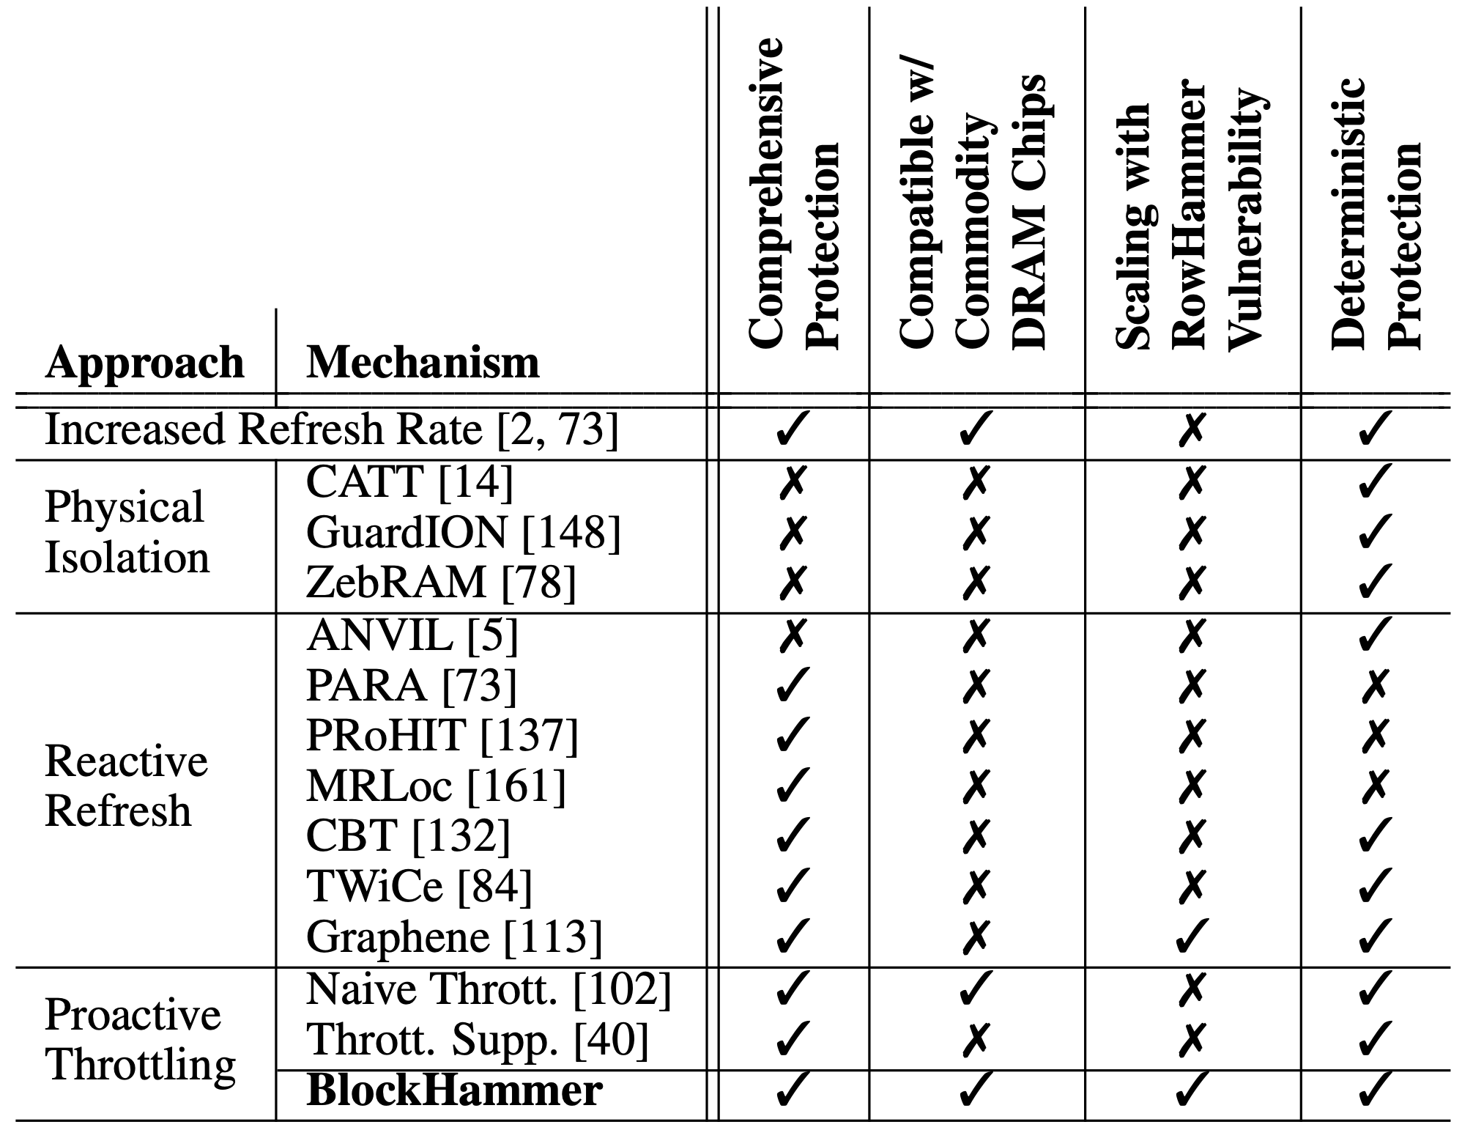
More in the Paper
Security Proof
Mathematically represent all possible access patterns
We show that no row can be activated high-enough times to induce bit-flips when BlockHammer is configured correctly
Addressing Many-Sided Attacks
Evaluation of 14 mechanisms representing four mitigation approaches
Comprehensive Protection
Compatibility with Commodity DRAM Chips
Scalability with RowHammer Vulnerability
Deterministic Protection
Notes:
We provide more analyses and implementation details available in the full paper.
[CLICK] First, the paper shares a security proof where we mathematically represent ALL POSSIBLE access patterns and show that NO ROW can be activated at a high-enough rate to induce bit-flips when BlockHammer is configured correctly.
[CLICK] Second, the paper explains how BlockHammer addresses many-sided attacks by tuning its thresholds.
[CLICK] Third, we evaluate all four high-level RowHammer mitigation approaches through analyzing 14 mechanisms from four aspects
[CLICK] comprehensive protection
[CLICK] compatibiltiy with commodity DRAM chips
[CLICK] scalability with worsening RowHammer vulnerability
[CLICK] and deterministic protection.
[CLICK] We show that BlockHammer is the only mechanism that satisfies all of them.
[END]

Slide 50




Two Main Types of DRAM Refresh
Periodic Refresh: Periodically restores the charge DRAM cells leak over time
1
RowHammer: Repeatedly accessing a DRAM row can cause bit flips in other physically nearby rows
2
Preventive Refresh
DRAM Row
Preventive Refresh
Preventive Refresh: Mitigates RowHammer by refreshing physically nearby rows of a repeatedly accessed row
Notes:
DRAM Refresh is mainly used for two purposes [CLICK]
The first one is called: Periodic Refresh to periodically restore the charge that DRAM cells leak over time [CLICK]
The second one is relevant to a read-disturb error mechanism called RowHammer, where repeatedly accessing a DRAM row can cause bit flips in other physically near by rows [CLICK]
A common method of mitigating RowHammer is refreshing potentially affected rows, called preventive refresh [CLICK]

Slide 51
Periodic Refresh with Increasing DRAM Chip Density
A larger capacity chip has more rows to be refreshed
A smaller cell stores less charge
26% Slowdown
More periodic refresh operations incur larger performance overhead as DRAM chip density increases
Significant performance and energy overhead
Notes:
With increasing DRAM chip density, [CLICK]
More rows need to be refreshed [CLICK]
And cells can store smaller charge leading to more periodic refresh operations[CLICK]
In this plot, we sweep DRAM chip capacity on the x-axis and investigate how the performance overhead of DRAM refresh operations change[CLICK]
We observe 26% slowdown in system performance caused by periodic refreshes [CLICK]

Slide 52
Leveraging Heterogeneity
Significant variation in read disturbance vulnerability across DRAM rows
Key Idea: To dynamically adapt the aggressiveness of existing solutions to the victim row’s read disturbance vulnerability
Key Results:
Weighted Speedup
(Norm. to No Mitigation Baseline)
Abdullah Giray Yağlıkçı, Yahya Can Tuğrul, Geraldo F. Oliveira, Ismail Emir Yuksel, Ataberk Olgun, Haocong Luo, and Onur Mutlu, "Spatial Variation-Aware Read Disturbance Defenses: Experimental Analysis of Real DRAM Chips and Implications on Future Solutions,” to appear in HPCA, 2024.
Minimum Hammer Count to Induce the First Bitflip
Notes:
I will also explain two improvements for defense mechanisms in this slide, but you can find more in the paper [CLICK]
The first improvement leverages the variation across rows [CLICK]
We observe that 90% of the rows do not experience bit flips until the activation count reaches the double Hcfirst of the 10% of the rows.[CLICK]
Therefore, we can reduce the aggressiveness of defense mechanisms for 90% of the rows, which can reduce the area overheads of state-of-the-art defense mechanisms: [CLICK] BlockHammer and [CLICK] Graphene, by 33 and 80%, respectively [CLICK]
The second example leverages the variation in RowHammer vulnerability with temperature [CLICK]
We show that DRAM cells experience bit flips in bounded temperature ranges [CLICK]
To avoid bit flips, A DRAM row can be disabled when its cells are vulnerable to RowHammer at the current operating temperature [CLICK]

Slide 53



Solutions to DRAM Read Disturbance



Throttling Unsafe Accesses
Parallelizing Preventive Actions
Leveraging
Heterogeneity
Notes:
To this end, during my PhD research, [CLICK]
I conducted several studies to understand the sensitivity of DRAM read disturbance to[CLICK]
temperature [CLICK]
access patterns [CLICK]
in-chip variations [CLICK]
and voltage [CLICK]

Slide 54
Our Goal
To understand the spatial variation
in read disturbance across DRAM rows
To leverage this understanding to improve
the existing read disturbance solutions

Slide 55
Detailed Information on Tested DRAM Chips
Significant variation in read disturbance vulnerability across DRAM rows
Key Idea: To dynamically adapt the aggressiveness of existing solutions to the victim row’s read disturbance vulnerability
Key Results:
Weighted Speedup
(Norm. to No Mitigation Baseline)
Abdullah Giray Yağlıkçı, Yahya Can Tuğrul, Geraldo F. Oliveira, Ismail Emir Yuksel, Ataberk Olgun, Haocong Luo, and Onur Mutlu, "Spatial Variation-Aware Read Disturbance Defenses: Experimental Analysis of Real DRAM Chips and Implications on Future Solutions,” to appear in HPCA, 2024.
Minimum Hammer Count to Induce the First Bitflip
Notes:
I will also explain two improvements for defense mechanisms in this slide, but you can find more in the paper [CLICK]
The first improvement leverages the variation across rows [CLICK]
We observe that 90% of the rows do not experience bit flips until the activation count reaches the double Hcfirst of the 10% of the rows.[CLICK]
Therefore, we can reduce the aggressiveness of defense mechanisms for 90% of the rows, which can reduce the area overheads of state-of-the-art defense mechanisms: [CLICK] BlockHammer and [CLICK] Graphene, by 33 and 80%, respectively [CLICK]
The second example leverages the variation in RowHammer vulnerability with temperature [CLICK]
We show that DRAM cells experience bit flips in bounded temperature ranges [CLICK]
To avoid bit flips, A DRAM row can be disabled when its cells are vulnerable to RowHammer at the current operating temperature [CLICK]

Slide 56
Future Research
The effect of aging
Preliminary data on aging via 68-day of hammering
Min. Hammer Count to Induce Read Disturbance Bitflips HC_{first} (after aging)
Aging can lead to read disturbance bitflips at fewer hammers
Min. Hammer Count to Induce Read Disturbance Bitflips HC_{first} (before aging)

Slide 57

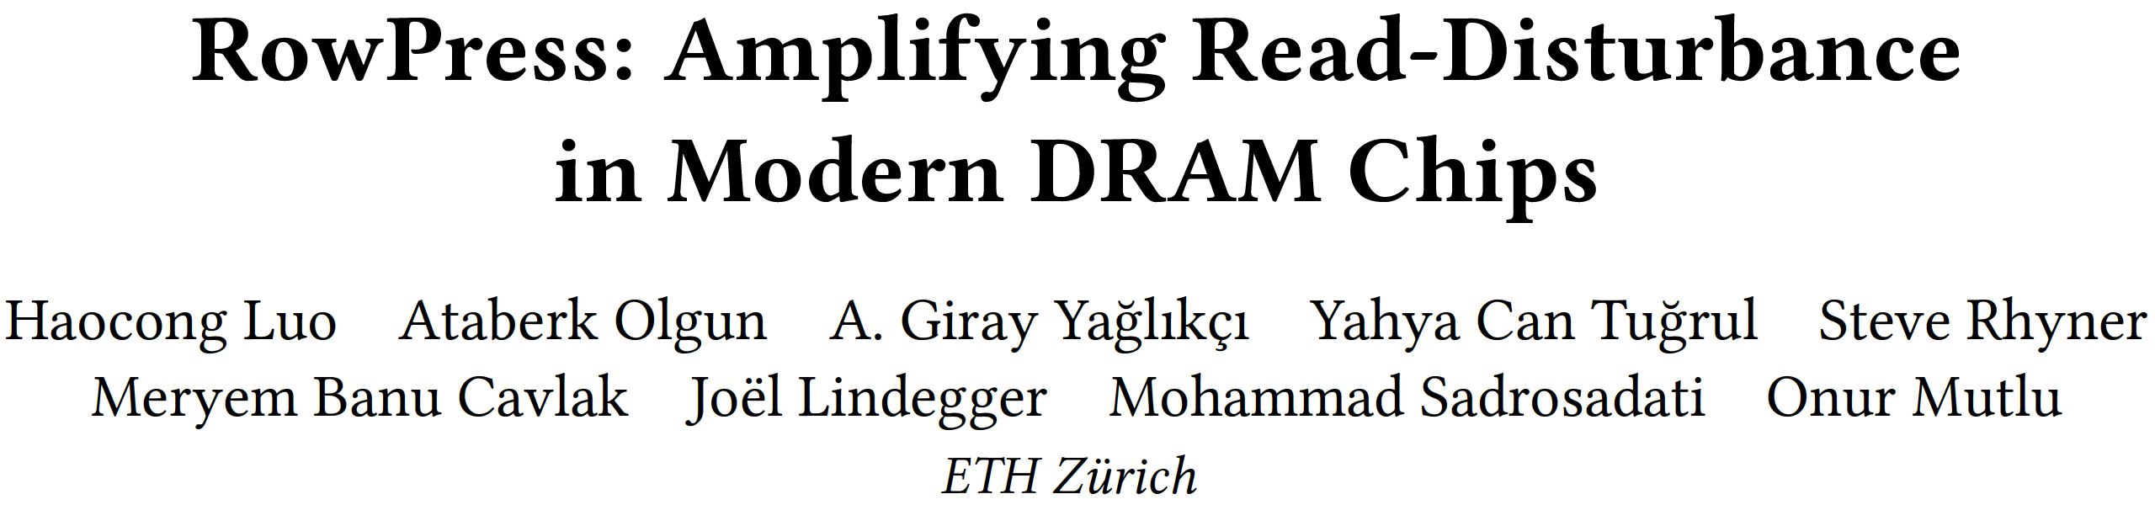
RowPress [ISCA 2023]
Haocong Luo, Ataberk Olgun, Giray Yaglikci, Yahya Can Tugrul, Steve Rhyner, M. Banu Cavlak, Joel Lindegger, Mohammad Sadrosadati, and Onur Mutlu, "RowPress: Amplifying Read Disturbance in Modern DRAM Chips" Proceedings of the 50th International Symposium on Computer Architecture (ISCA), Orlando, FL, USA, June 2023. [Slides (pptx) (pdf)] [Lightning Talk Slides (pptx) (pdf)] [Lightning Talk Video (3 minutes)] [RowPress Source Code and Datasets (Officially Artifact Evaluated with All Badges)] Officially artifact evaluated as available, reusable and reproducible. Best artifact award at ISCA 2023.

Slide 58
RowPress A New DRAM Read Disturbance Phenomenon
DRAM Subarray
Row 0
Row 1
Row 1
Row 1
Victim Row
Row 2
Row 2
Row 2
Row 2
Row 2
open
open
open
closed
Aggressor Row
Aggressor Row
Row 3
Row 3
Row 3
Row 2
Victim Row
closed
Row 4
Keeping a DRAM row open (activated)
causes RowPress bitflips in nearby cells
Notes:
Due to an increase in cell-to-cell interference, as a result of aggressive technology node scaling, rapidly activating [CLICK] and precharging
[FORTH & BACK] a DRAM row can result in bit flips in physically adjacent rows [CLICK]
[FORTH & BACK] Continuing to access the same row results in even more failures in nearby rows. This phenomenon is known as RowHammer. [CLICK]
We refer to the rapidly accessed row as an aggressor row and the rows containing bit flips as victim rows.

Slide 59
Two Prime Examples of DRAM Read Disturbance: RowHammer and RowPress
Instead of using a high activation count,
☞ increase the time that the aggressor row stays open
RowHammer
Aggressor Row
Open
Close
RowPress
Aggressor Row
Open
Close
Notes:
Instead of a high activation count, RowPress increases the time the that aggressor stays open.
Doing disturbs adjacent rows enough to cause bitflips without a very high activation count.
We observe bitflips even with only one activation in extreme cases.

Slide 60
RowPress [ISCA 2023]
Haocong Luo, Ataberk Olgun, Giray Yaglikci, Yahya Can Tugrul, Steve Rhyner, M. Banu Cavlak, Joel Lindegger, Mohammad Sadrosadati, and Onur Mutlu, "RowPress: Amplifying Read Disturbance in Modern DRAM Chips" Proceedings of the 50th International Symposium on Computer Architecture (ISCA), Orlando, FL, USA, June 2023. [Slides (pptx) (pdf)] [Lightning Talk Slides (pptx) (pdf)] [Lightning Talk Video (3 minutes)] [RowPress Source Code and Datasets (Officially Artifact Evaluated with All Badges)] Officially artifact evaluated as available, reusable and reproducible. Best artifact award at ISCA 2023.

Slide 61
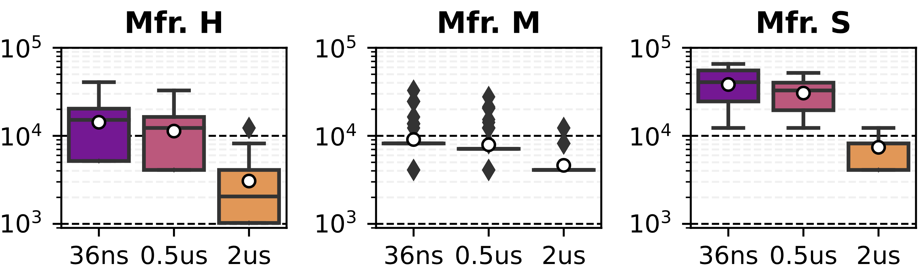
Effect of RowPress on Spatial Variation of Read Disturbance Vulnerability across Rows
Effect of RowPress on the HC_{first} Distribution
Minimum Hammer Count
To Induce the First Bitflip
(HC_{first})
Aggressor Row’s On Time (t_{AggOn}) (ns)
RowPress reduces the mean of the distribution with increased t_{AggOn}
There is still significant variation in the HC_{first} across rows

Slide 62
Effect of RowPress on the HCfirst Distribution
Minimum Hammer Count
To Induce the First Bitflip
(HC_{first})
Aggressor Row’s On Time (t_{AggOn}) (ns)
Aggressor Row’s On Time (t_{AggOn}) (ns)
Bitflips occur at lower hammer counts with RowPress and these hammer counts still significantly vary across DRAM rows
Notes:
Assume that an attacker hammers a row to induce bit flips in its nearby rows [CLICK]
Existing RowHammer defenses detect the attack [CLICK]
And try refreshing the nearby rows [CLICK]
However, the DRAM chip can internally map these row addresses to different physical rows [CLICK]
And thus bit flips may still occur[CLICK]
To avoid this, existing mechanisms need to know proprietary DRAM-internal row address mapping [CLICK]

Slide 63
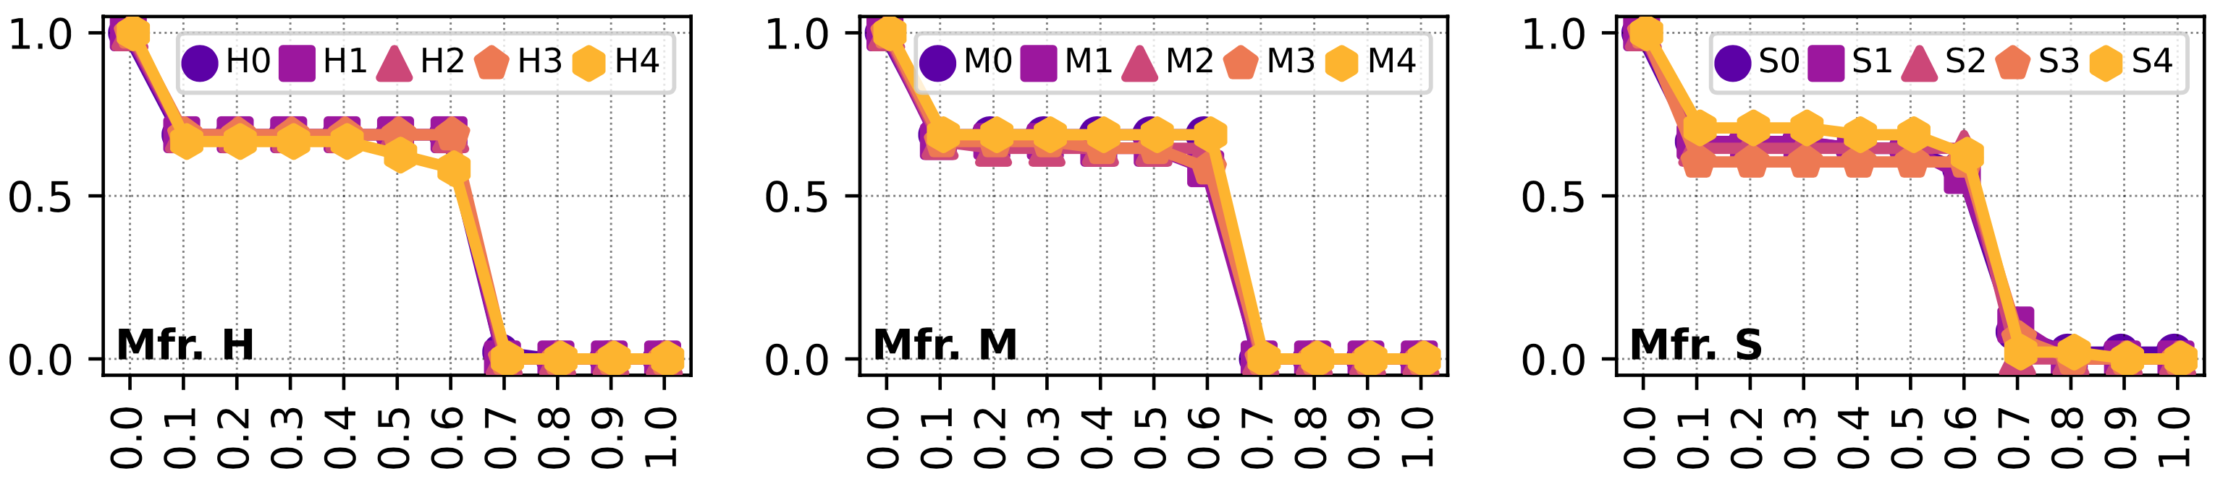
Cumulative Distribution of Spatial Features based on F1 Score
Different DRAM modules
More than 50% of the features have F1 scores larger than 0.1
Cumulative Distribution
of Spatial Features
F1 score
No good prediction observed between a row’s spatial features & read disturbance vulnerability
Notes:
Make the x-axis more intuitive

Slide 64
Cumulative Distribution of Spatial Features based on F1 Score
Different DRAM modules
Cumulative Distribution of Spatial Features
F1 score
F1 score
F1 score
A few spatial features from Mfr. S can exhibit F1 score >0.7
No good prediction observed between a row’s spatial features & read disturbance vulnerability
Notes:
Make the x-axis more intuitive

Slide 65
An Outlier Solution: Hydra
Weighted Speedup
(Norm. to No Mitigation Baseline)
Only 3% Speedup
Minimum Hammer Count to Induce the First Bitflip

Slide 66
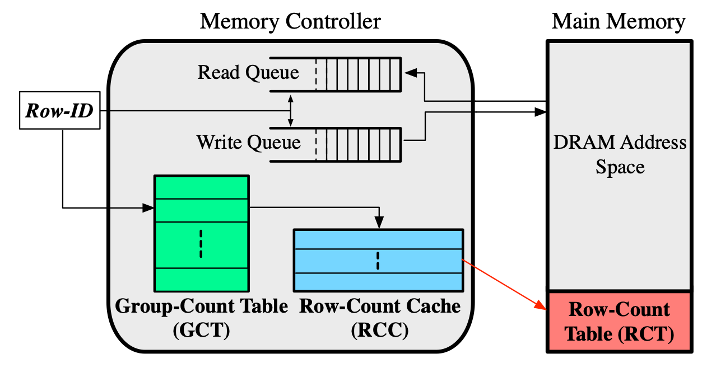
Hydra Mitigation Mechanism
Hydra maintains a row activation counter for each DRAM row
Stores these activation counters in the DRAM array
Caches the counters of hot rows in the memory controller
At low HC_{first} configurations, many rows are hot
Fetching / evicting counters dominate the performance overhead
Svärd needs further customizations for Hydra
Qureshi, et al. "Hydra: Enabling Low-Overhead Mitigation of Row-Hammer at Ultra-Low Thresholds via Hybrid Tracking," in ISCA, 2022.

Slide 67
Conclusion
Experimental study: 136 DDR4 DRAM chips from 3 major vendors
A large variation in the necessary activation count to induce the first bitflip
No strong correlation between a row’s spatial features and its vulnerability to read disturbance
SVÄRD: Dynamically adapts the aggressiveness of mitigations
Implemented in either the DRAM chip or the memory controller
Reduces the performance overheads by 2.4x, 2.7%, 1.6x, and 3.0x for BlockHammer, Hydra, PARA, and RRS
Future Work:
A deeper understanding is needed to account for irregularities in row and column addresses across chips
Finding correlations is essential to reduce the hardware cost
Reducing also the hardware cost of defenses
Notes:
RowHammer is a worsening DRAM reliability and security problem [CLICK]
However, state-of-the-art RowHammer mitigation mechanisms face limitations supporting current and future commodity DRAM chips because of two challenges [CLICK]
First, they cannot scale efficiently with worsening RowHammer vulnerability[CLICK]
Second, they are not compatible with commodity DRAM chips as they rely on proprietary information [CLICK]
To overcome these two challenges, our key idea is to SELECTIVELY throttle memory accesses that may cause RowHammer bit flips

Slide 68
RowHammer Mitigation across Generations
10⁵
10⁴
10³
10²
Ideal
14%
TWiCe-ideal
PARA
LPDDR4-1x
LPDDR4-1y
DDR3-old
DDR3-new
DDR4-new
DDR4-old
10⁵
10⁴
10³
10²
HC_{first} (number of hammers required to induce first RowHammer bit flip)
J. S. Kim, M. Patel, A. G. Yaglikci, H. Hassan, R. Azizi, L. Orosa, and O. Mutlu, "Revisiting RowHammer: An Experimental Analysis of Modern Devices and Mitigation Techniques,” in ISCA, 2020.

Slide 69
Spatial Variation-Aware Read Disturbance Defenses: Experimental Analysis of Real DRAM Chips and Implications on Future Solutions
Backup Slides
Abdullah Giray Yağlıkçı
Yahya Can Tuğrul Geraldo F. Oliveira İsmail Emir Yüksel
Ataberk Olgun Haocong Luo Onur Mutlu
Notes:
Hi my name is Giray and I am happy to share my research with you

